Slide 1
Broker Portal
Application Transfer Link

Slide 2
Application link sent to shopper when quote is created.
“Verify Email” will display the email that will receive the quote under verify email
If the email address is correct select “Create Quote”
If email address isn’t correct, select ‘edit email’ to correct email address.

Slide 3
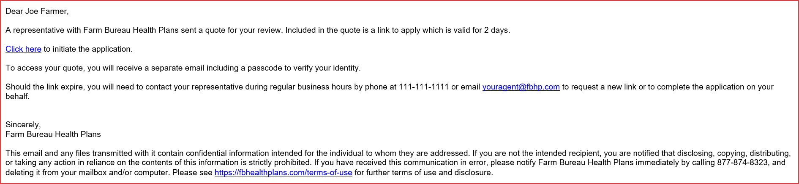
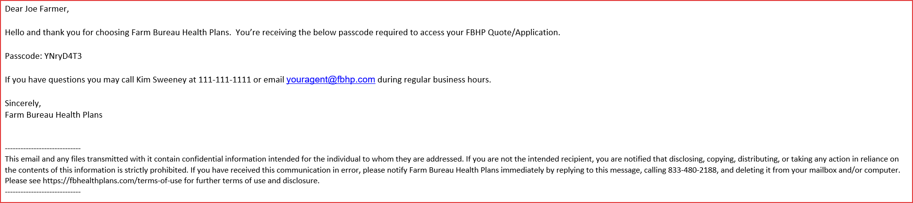
An email will be generated which will include the initiate application link and alphanumeric passcode set to expire after 2 days.
Initiate Application Email
Alphanumeric Passcode Email

Slide 4
Shopper Clicks on Initiate Application Link
Applicant will enter the alphanumeric passcode
Click on “Next”
Applicant will ‘Register’ an account or ‘Login’ if an account has already been created.
Click on “Next”

Slide 5
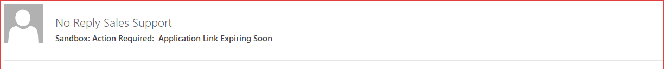
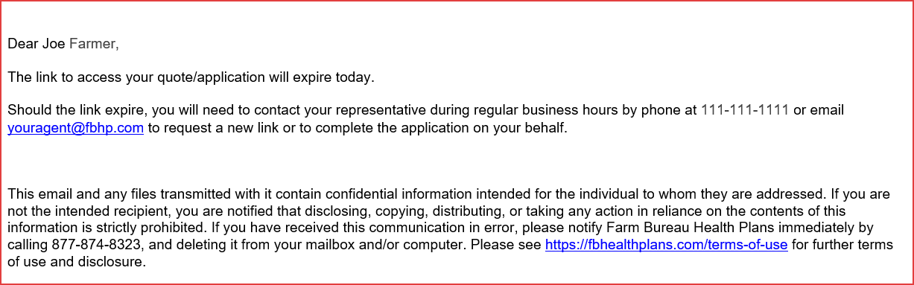
A reminder email will be generated to shopper to complete the application within 2 Days.

Slide 6
Agent transfers the in-progress application to shopper.
‘Save and Exit’ during any portion of the application process.
‘Confirm’ that you want to exit the application.
Select ‘Yes’ to ‘Would you like to transfer the application to the Shopper./Prospect so they can finish? ‘
Verify email address
Select ‘Send’

Slide 7
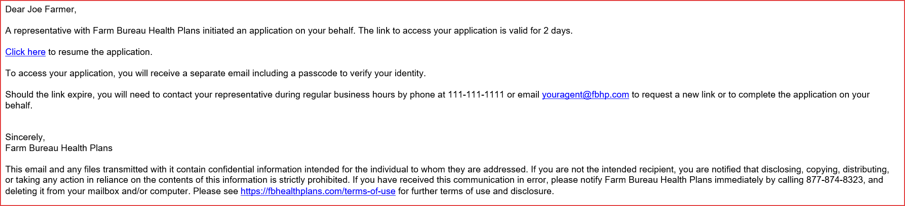
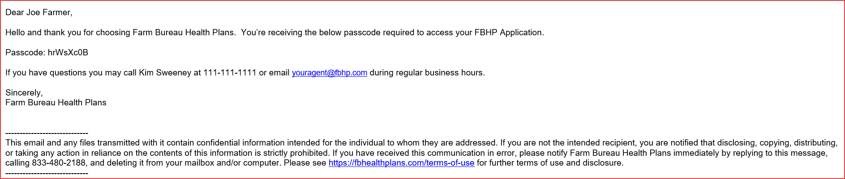
An email will be generated informing the shopper that an application was initiated, and alphanumeric passcode set to expire after 2 days.
Link to Resume Your FBHP Application email
Authorization Code Email

Slide 8
Resend Resume Application Link to the Shopper
Select’ Send Resume Application Link’
You will receive a message that email was sent successfully to email address on file
Email Sent Successfully to jfarmer@email.com

Slide 9
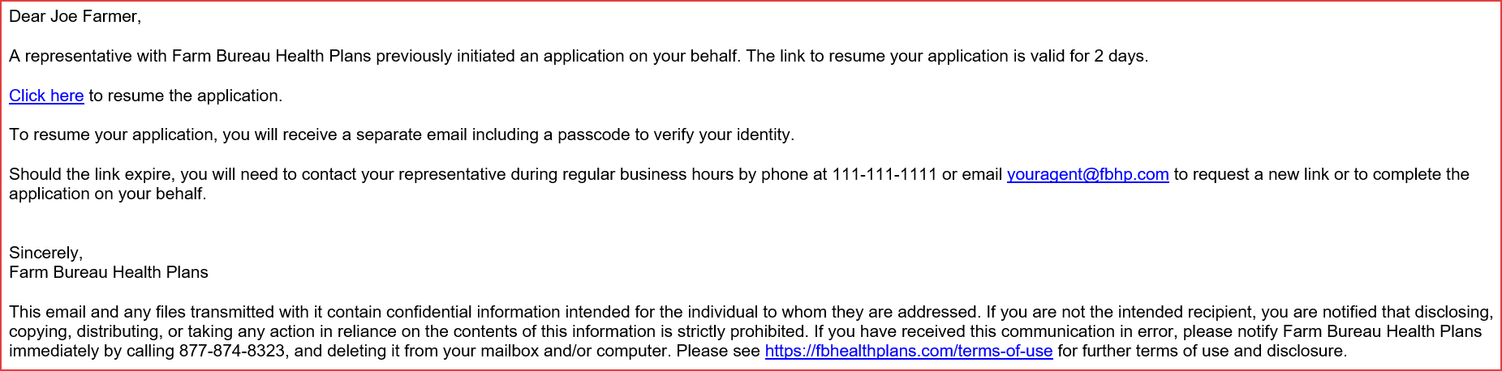
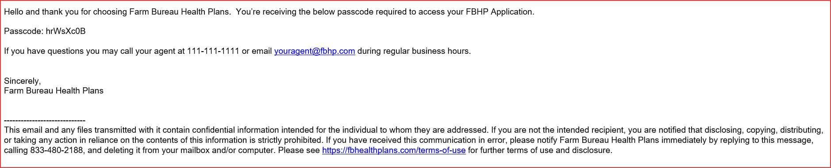
An email will be generated informing the shopper that an application was initiated, and alphanumeric passcode set to expire after 2 days.
Link to Resume Your FBHP Application email
Authorization Code Email

Slide 10
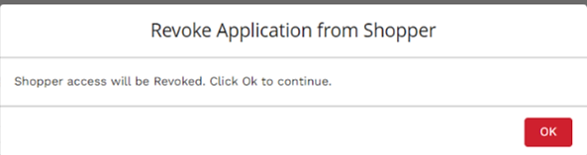
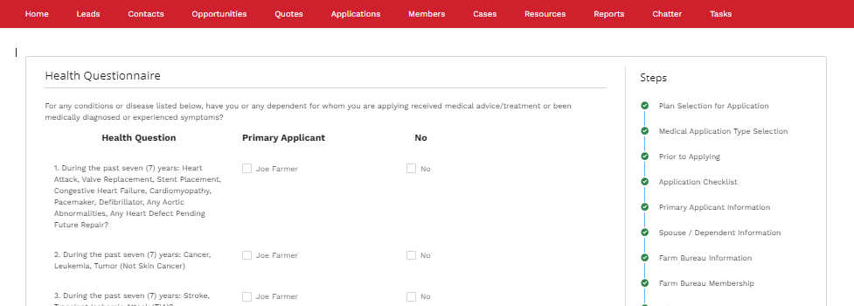
Agent revokes the shopper access and takes back the ownership of application.
Select’ Resume Application’
Confirm that you want to revoke access from the shopper.
Shopper access will be Revoked. Click OK to continue.
OK
Agent will be able to pick up the application and start from where the shopper stopped.

